Slide 1



Running Speeds and Imbalance
Ian McElveen and Cecilia Gonzales

Slide 2
Running Speeds

Slide 3
How often are athletes reaching ≥ 90% maximum velocity throughout the training season?

Slide 4
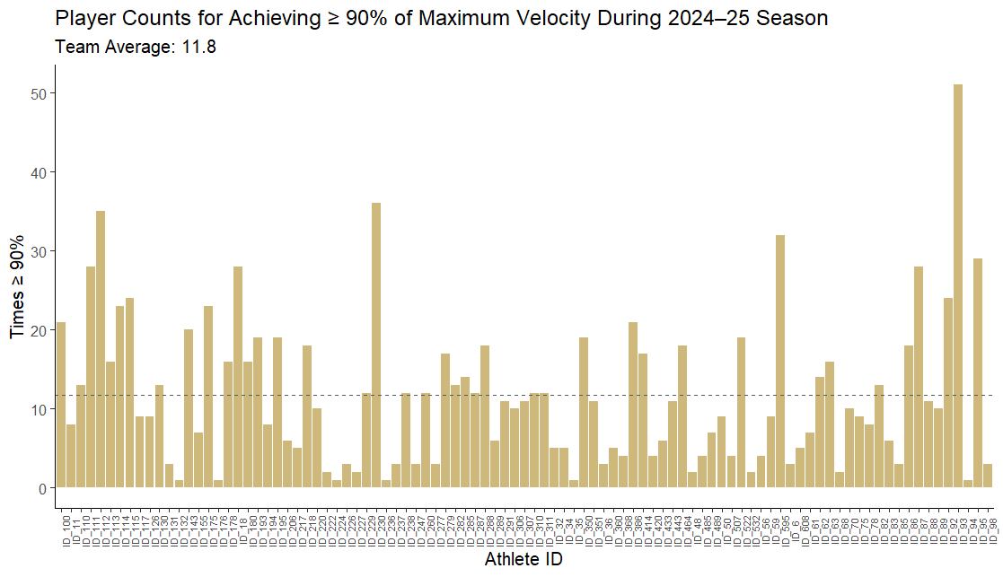
Reaching ≥ 90% Max

Slide 5
Reaching ≥ 90% Max
Position | Average Times ≥ 90% Max
Team | 11.8
DB | 18.4
WR | 15.7
DL | 10.8
RB | 10.5
QB | 9.8
LB | 8.9
TE | 8.4
OL | 6.8
Position Group | Average Times ≥ 90% Max
Team | 11.8
SKILL (DB, WR) | 17.1
COMBO (QB, RB, TE, LB) | 9.3
BIGS (OL, DL) | 8.9

Slide 6
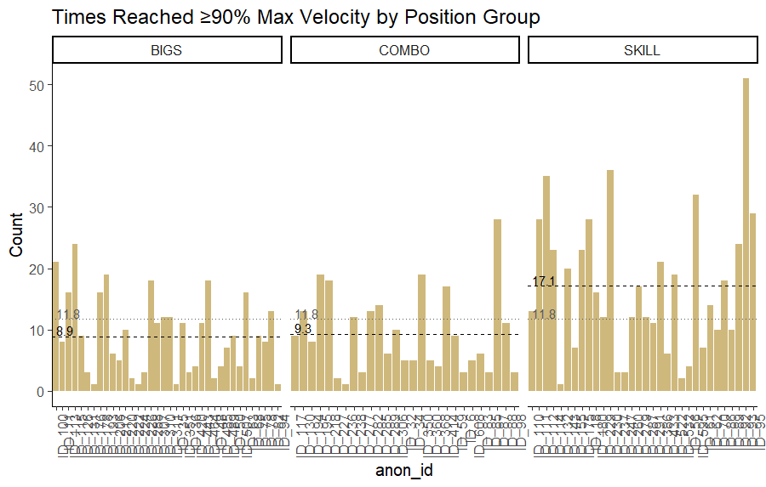
Reaching ≥ 90% Max

Slide 7
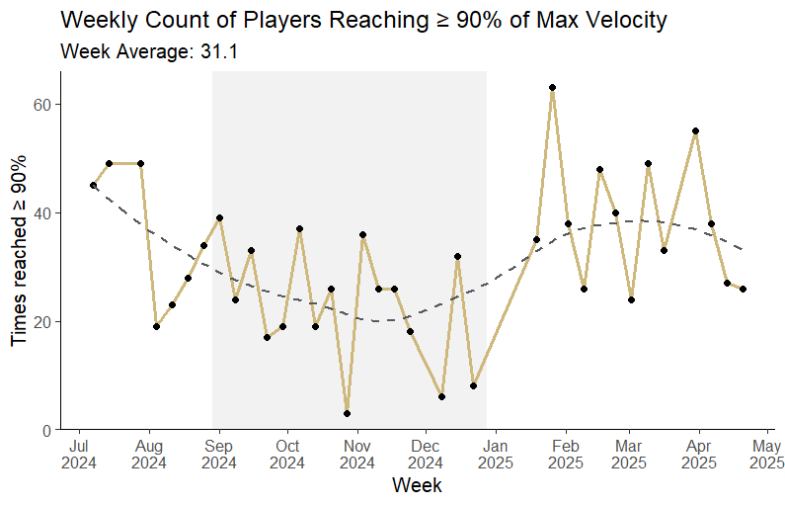
Reaching ≥ 90% Max

Slide 8
Should we consider the number of sprinting efforts that athletes are completing?

Slide 9
Velocity Bands and Speed
How often athletes are hitting which absolute velocity bands in relation to their top speeds.
Band | Velocities (mph)
1 | 0 - 5
2 | 5.01 - 7
3 | 7.01 - 8.99
4 | 9.0 - 11.99
5 | 12 - 13.98
6 | 13.98 - 15.99
7 | 16 - 17
8 | 17.01 +

Slide 10
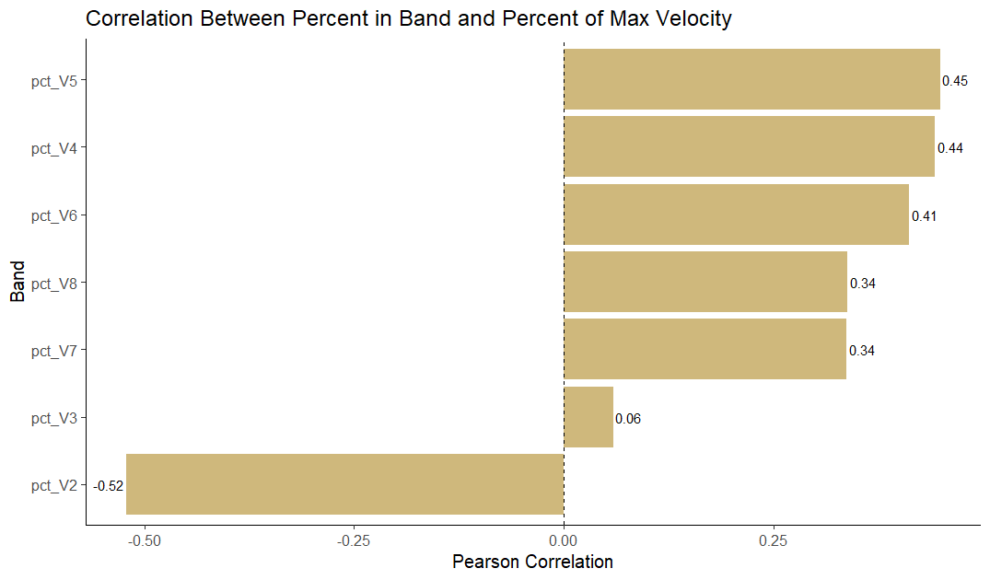
Velocity Bands and Speed

Slide 11
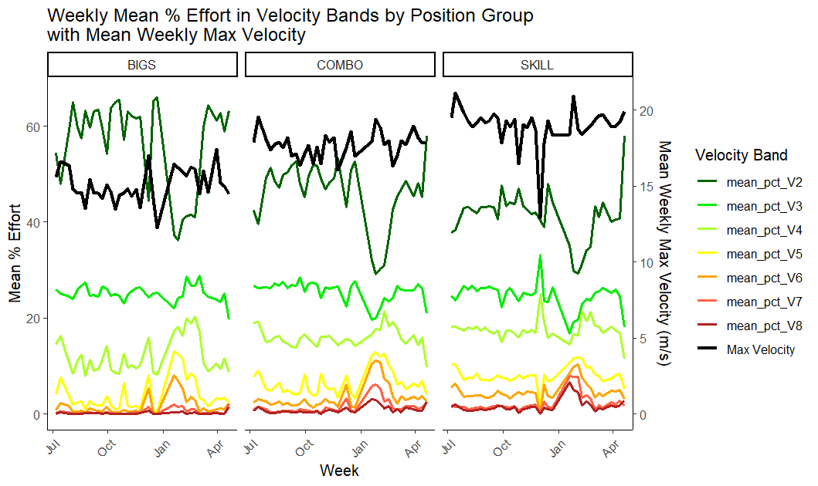
Velocity Bands and Speed
Absolute Modeling Results:
Bigs:
Band 6 shows largest links to max velocity
Skill:
Higher effort in Band 4 = lower max velocity
Combo:
Hard to model (QBs, RBs, TEs, and LBs)

Slide 12
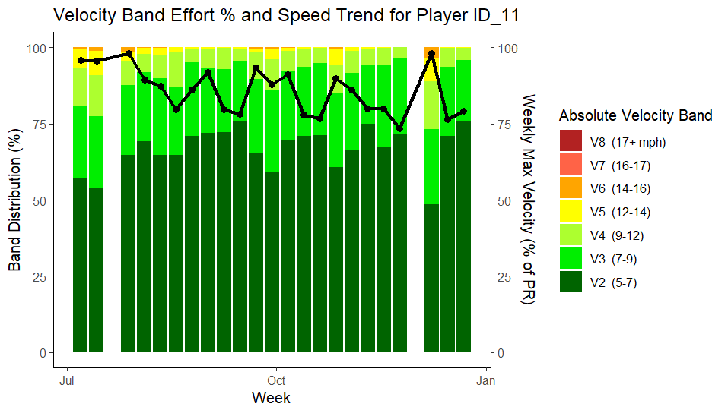
Velocity Bands and Speed

Slide 13
Are relative efforts and bands more advantageous than the absolute bands provided?

Slide 14
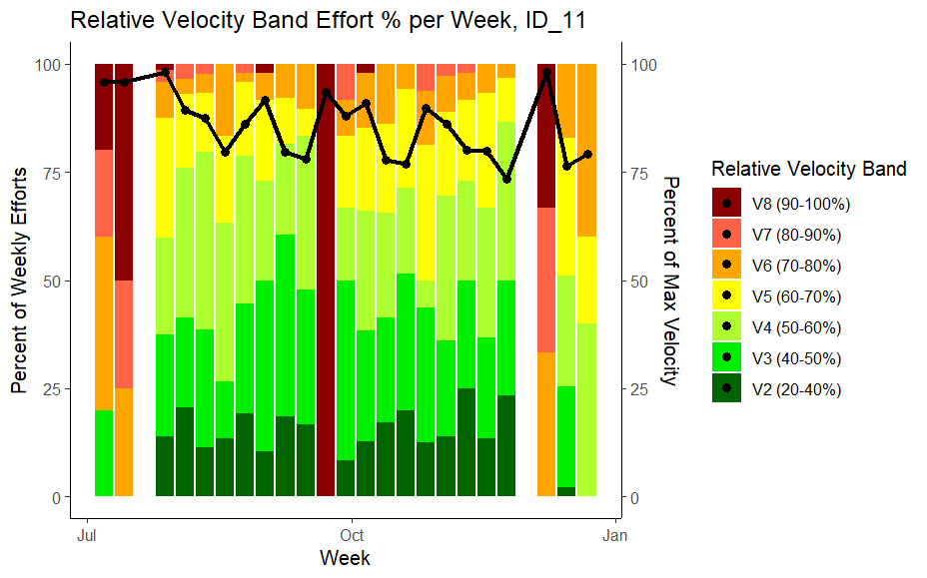
Relative vs. Absolute

Slide 15
How does sprinting exposure (# of counts, % of max) relate to incidence of hamstring injuries?

Slide 16
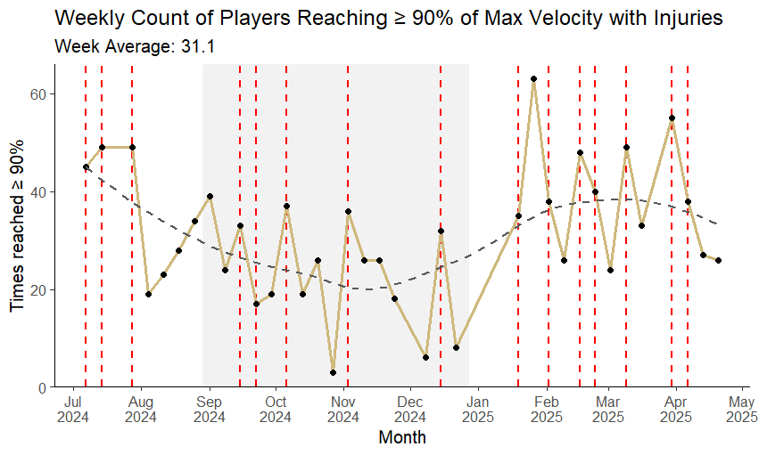
Sprint Count vs. HSI

Slide 17
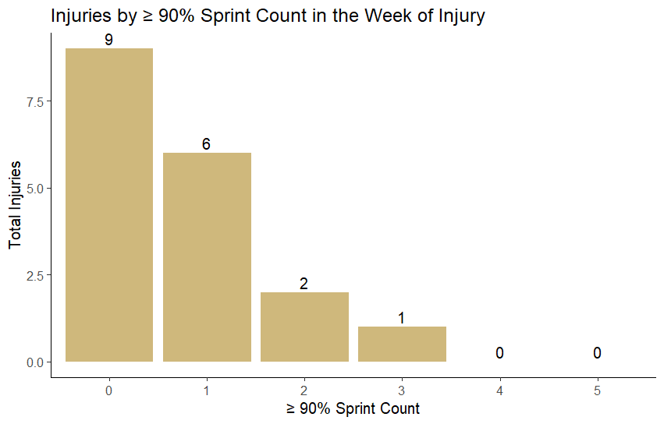
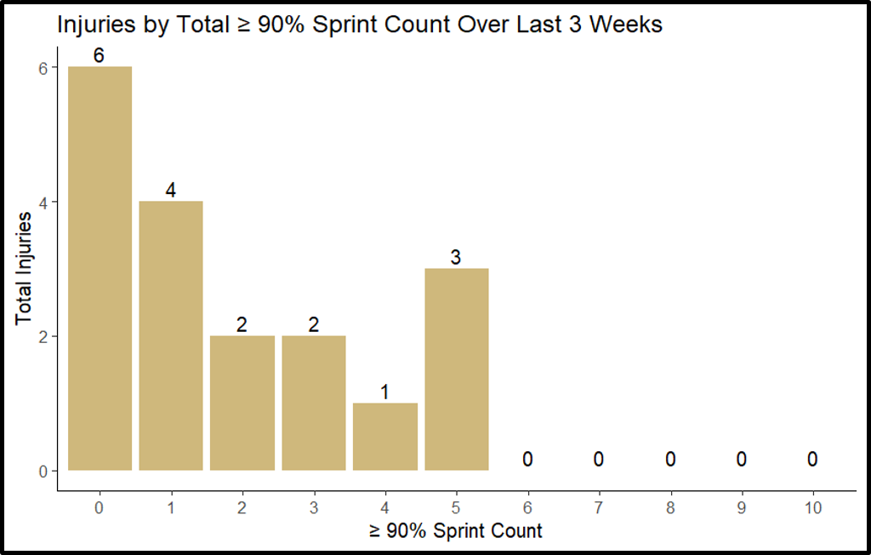
Sprint Count and HSI
Total Observations per Sprint Count:
0 = 1257
1 = 500
2 = 200
3 = 50
4 = 12*
5 = 1*
Total Observations per Sprint Count:
0 = 879
1 = 417
2 = 251
3 = 182
4 = 123
5 = 90
6 = 38*
7 = 23*
8 = 9*
9 = 5*

Slide 18
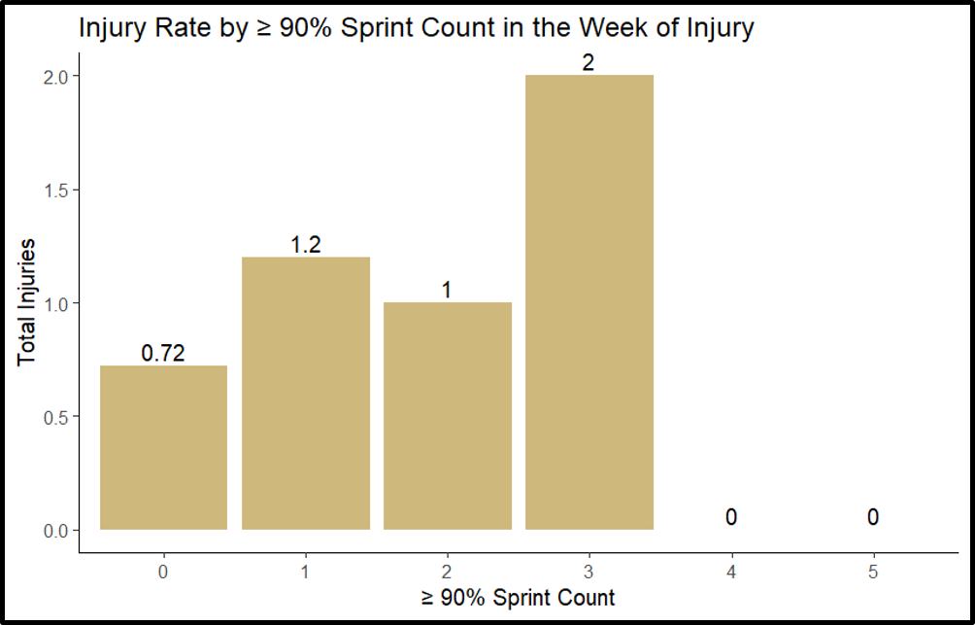
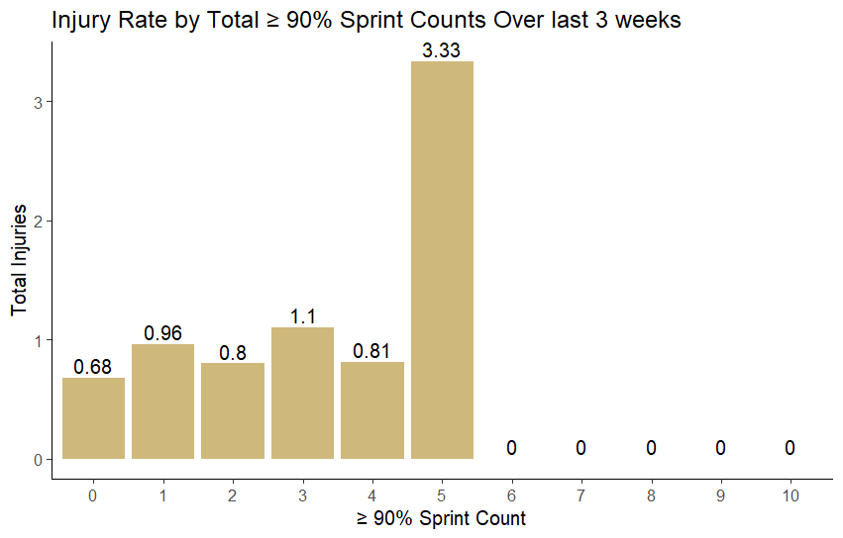
Sprinting and HSI
Fisher Exact tests revealed no associations.

Slide 19
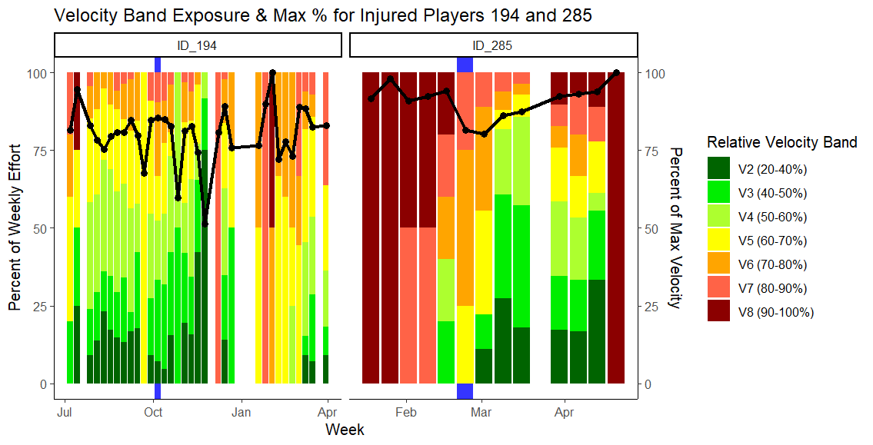
Percent of Max vs. HSI

Slide 20
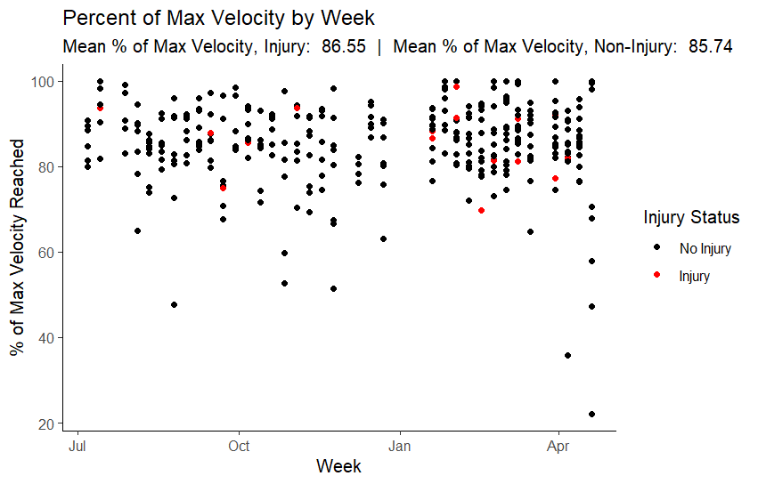
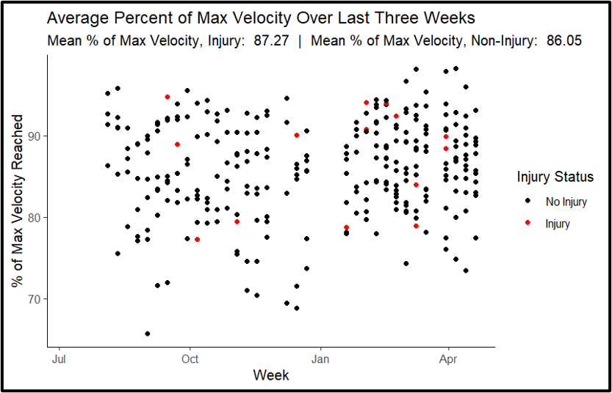
Percent of Max vs. HSI

Slide 21
Final Thoughts
Percent of Max vs. HSI
There was no statistically significant association between our sprint count groups and injury occurrence for a one- or three-week period.
There was no statistically significant difference in percent of max velocity between injury and non-injury groups
Since there were relatively few injuries in the dataset, it's harder to detect real differences between groups. This means non-significant results should be taken with caution, and future research with larger samples is highly recommended.

Slide 22
Running Imbalance

Slide 23
What is the variation at the team level and at each individual athlete level?

Slide 24
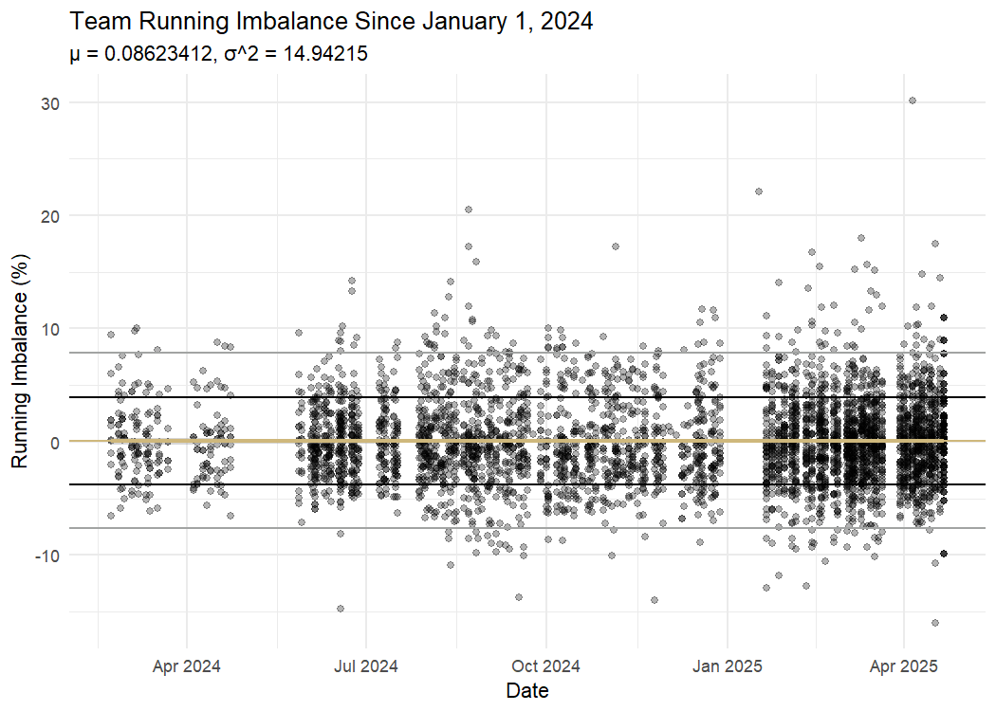
Team Trends
Team Variation

Slide 25
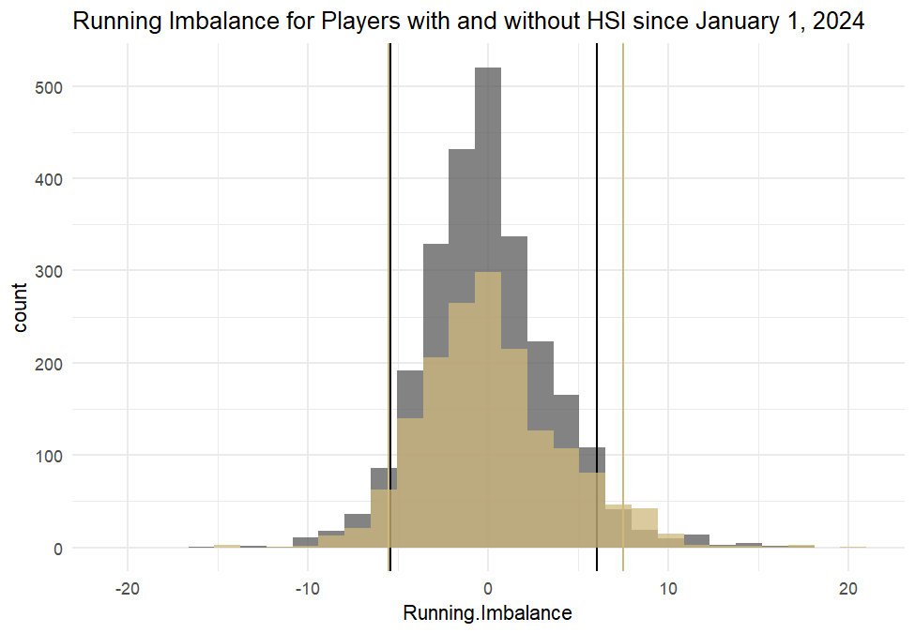
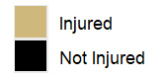
Running Imbalance by Status
Team Variation

Slide 26
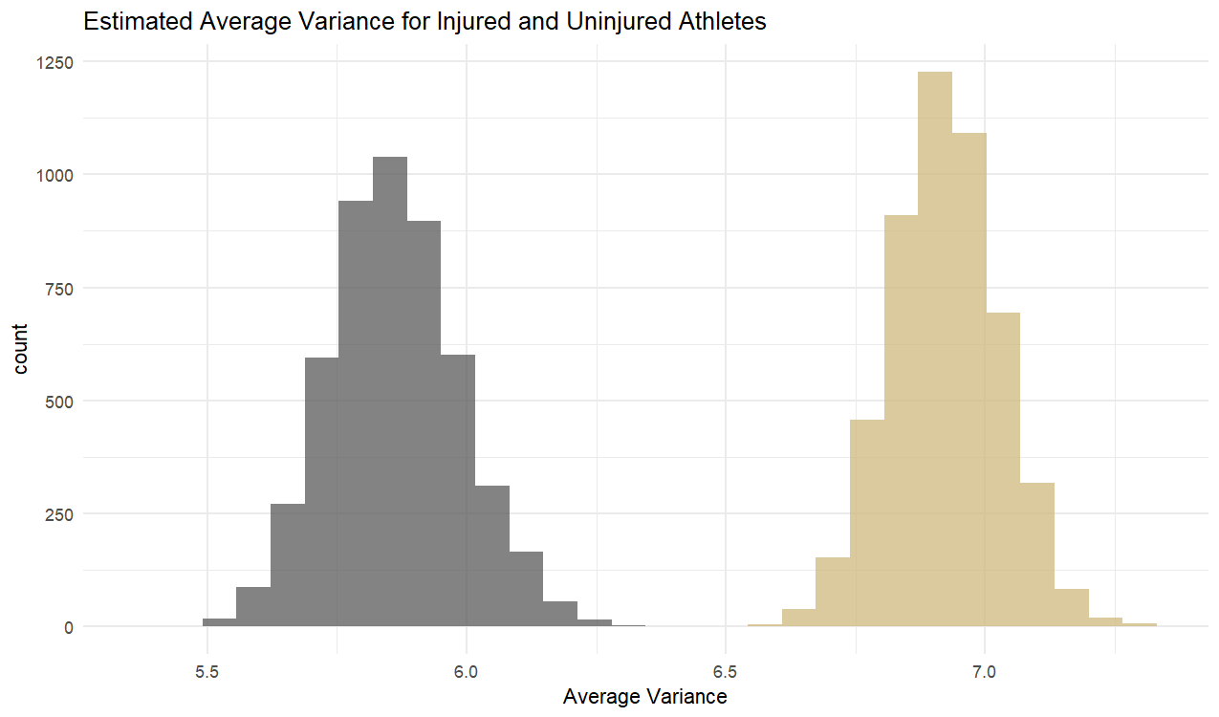
Average Variance by Status
Team Variation
Exploring the Relations Between Running Variability and Injury Susceptibility: A Scoping Review
By Zaheen Ahmed Iqbal and Daniel Hung-Kay Chow

Slide 27
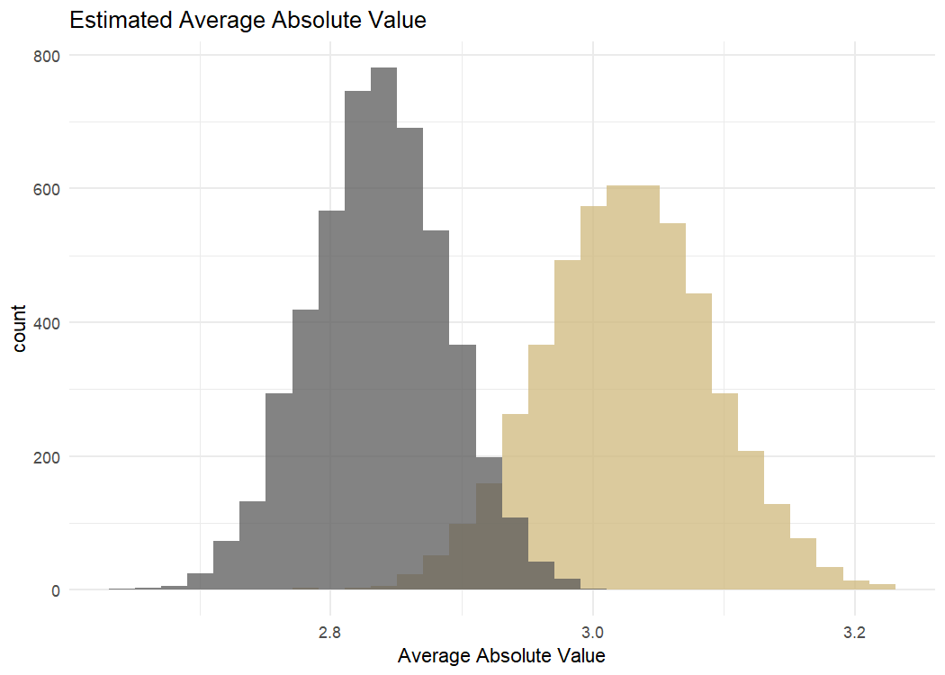
Average Absolute Value by Status
Team Variation

Slide 28
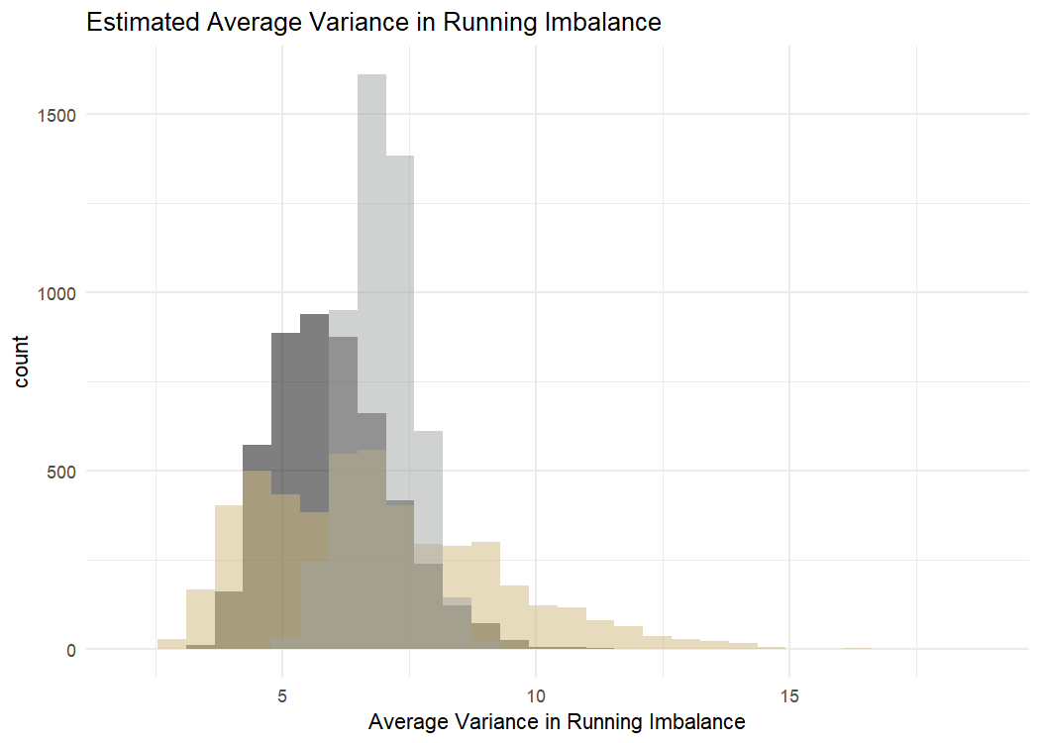
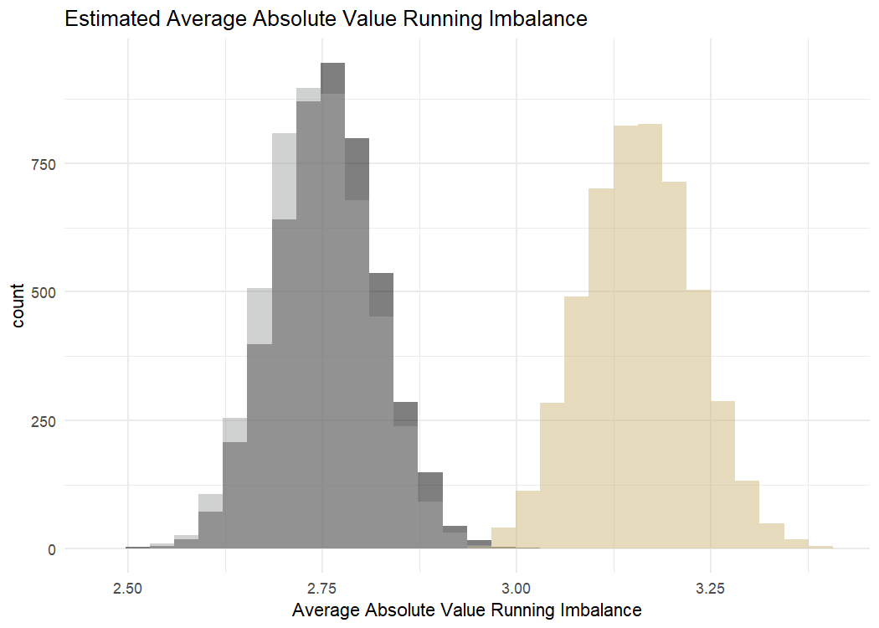
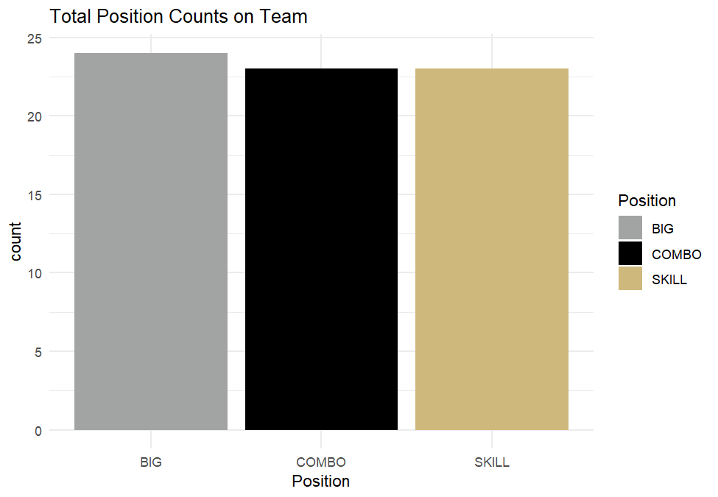
Running Imbalance by Position
Team Variation

Slide 29
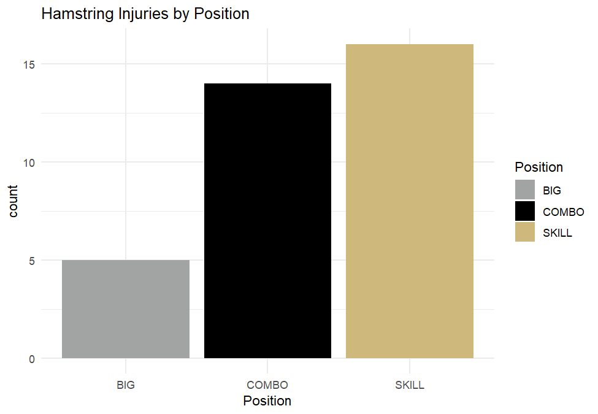
Team Variation

Slide 30
What is a meaningful change? What red flags should go off when we see a week-to-week change in running imbalance?

Slide 31
Running Imbalance and HSI Risk
Meaningful Change
No direct relationship between running imbalance value and impending HSI
No relationship with any summary statistic per week of running imbalance
Trends stay the same before and after HSI
Variance of running imbalance during time at CU is the best indicator of HSI occurrence

Slide 32
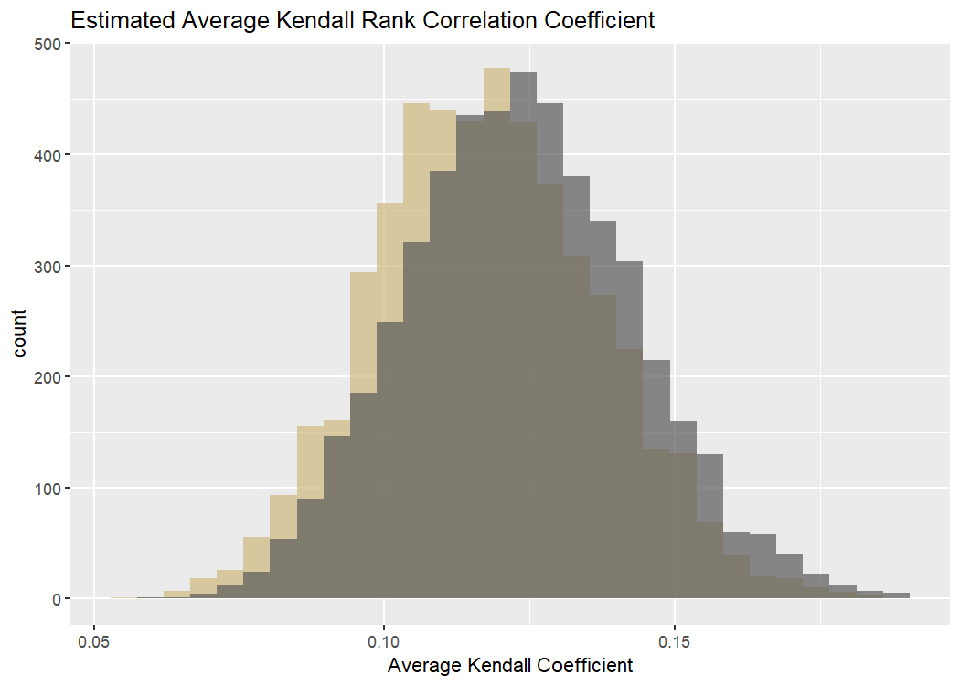
Trend Strength by Status
Meaningful Change

Slide 33
Is running imbalance sensitive enough of a metric to use as a prognosis tool versus a rehab tool?

Slide 34
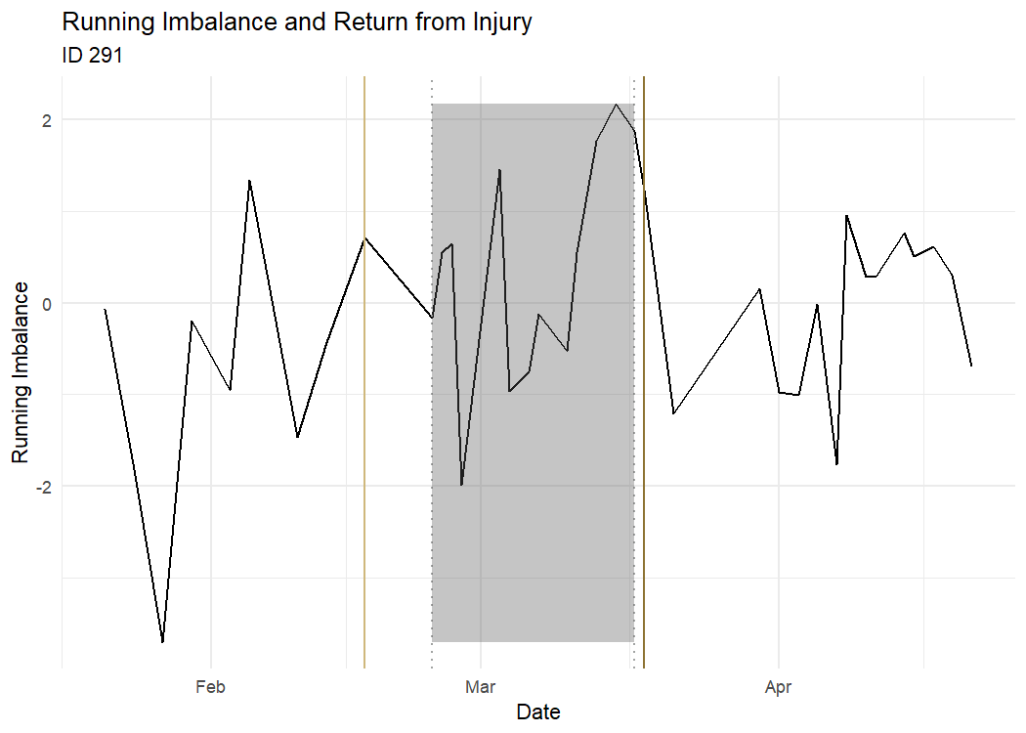
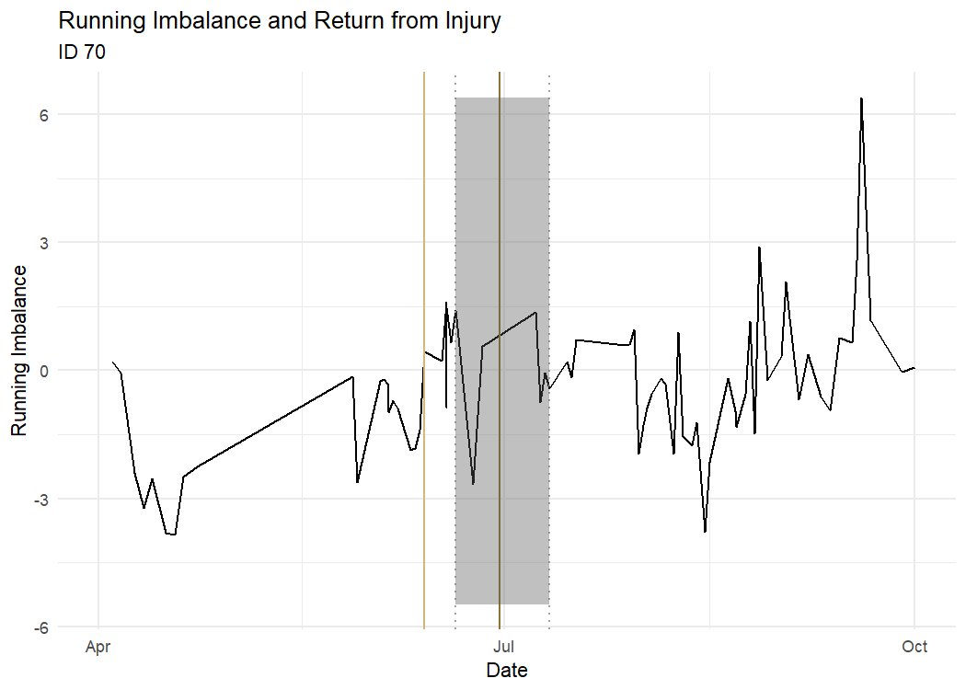
Return to Play Timeline
Use as a Prognosis Tool

Slide 35
Use as a Predictor
Use as a Prognosis Tool
Logistic Regression Model
Slope coefficient statistically significant at α = 0.01
Β = -0.04135
Cross Validated classification error rate of 0.4

Slide 36
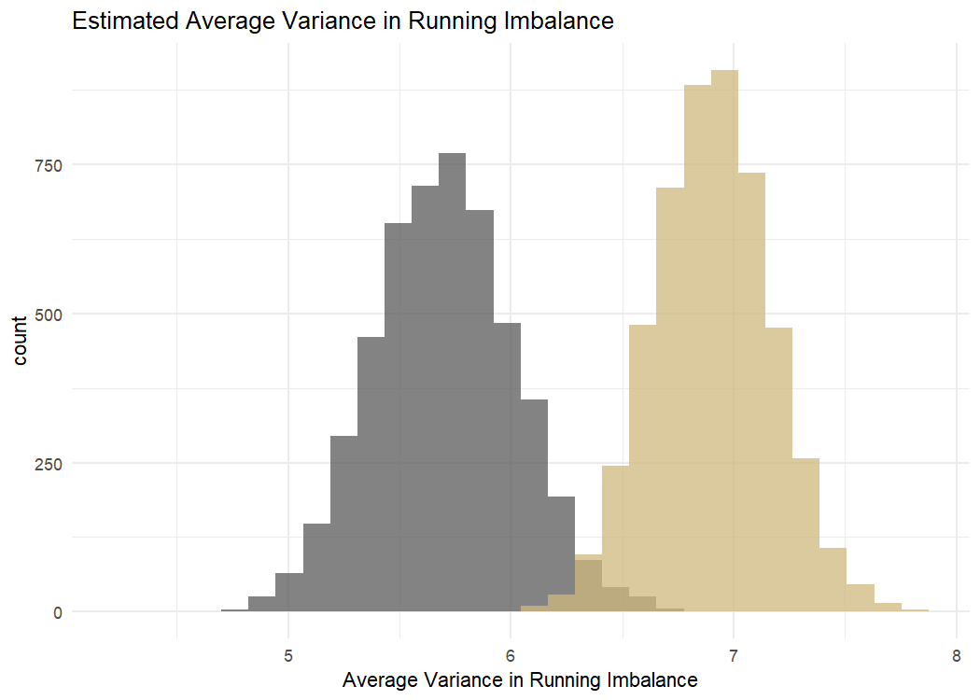
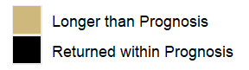
Average Variance by Status
Use as a Prognosis Tool

